Slide 1




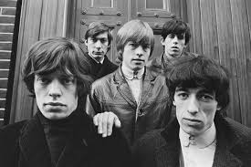


September’s musician is…
The Rolling Stones

Slide 2

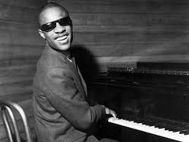
October’s musician is…
Stevie Wonder

Slide 3

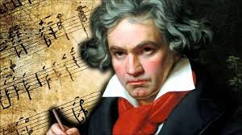
November’s musician is…
Ludwig van Beethoven

Slide 4

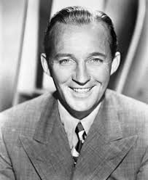
December’s musician is…
Bing Crosby

Slide 5

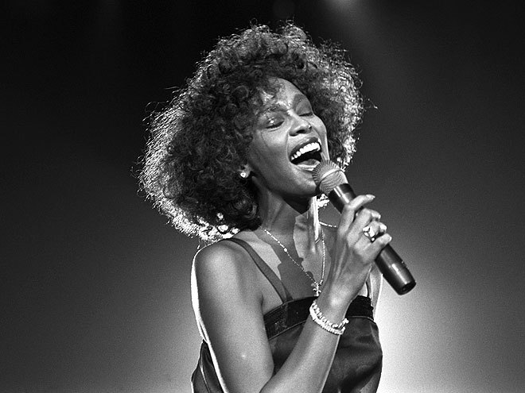
January’s musician is…
Whitney
Houston

Slide 6

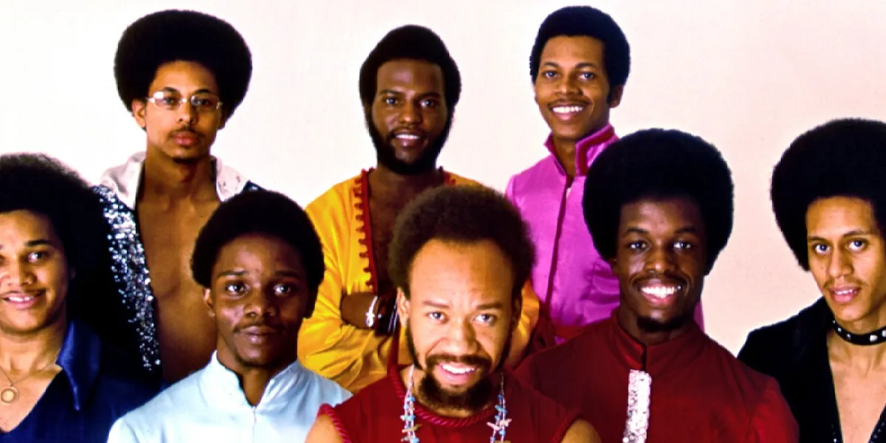
February’s musician is…
Earth, Wind
& Fire

Slide 7

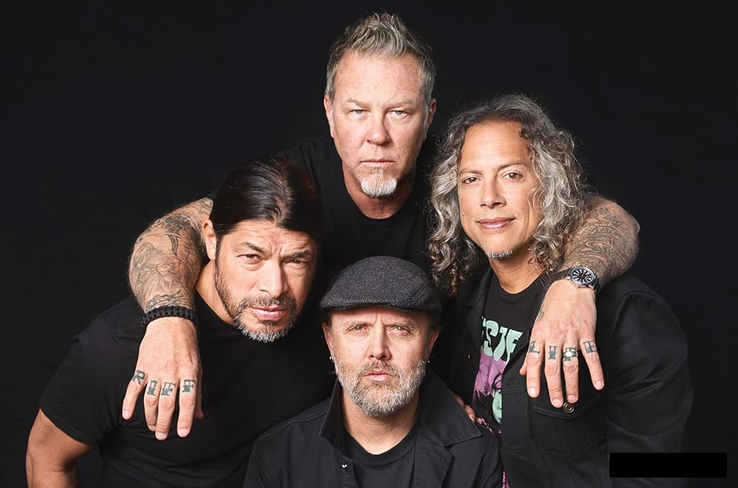
March’s musician is…
Metallica

Slide 8

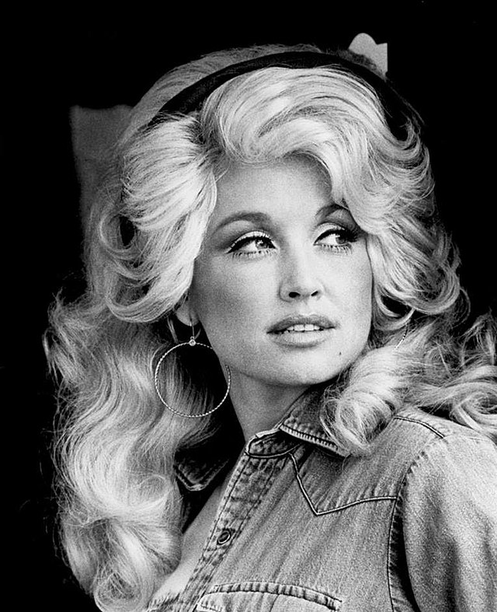
April’s musician is…
Dolly Parton

Slide 9

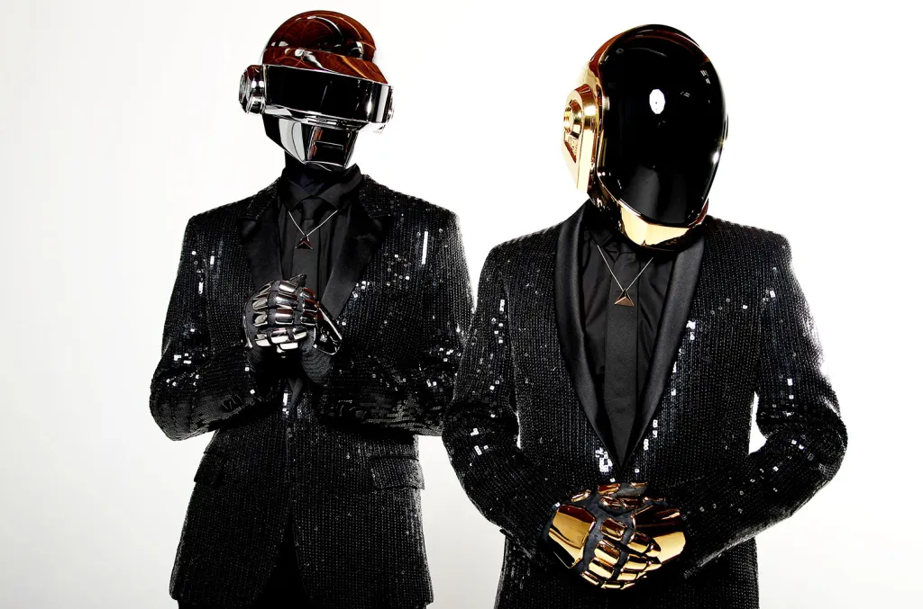
May’s musician is…
Daft Punk

Slide 10

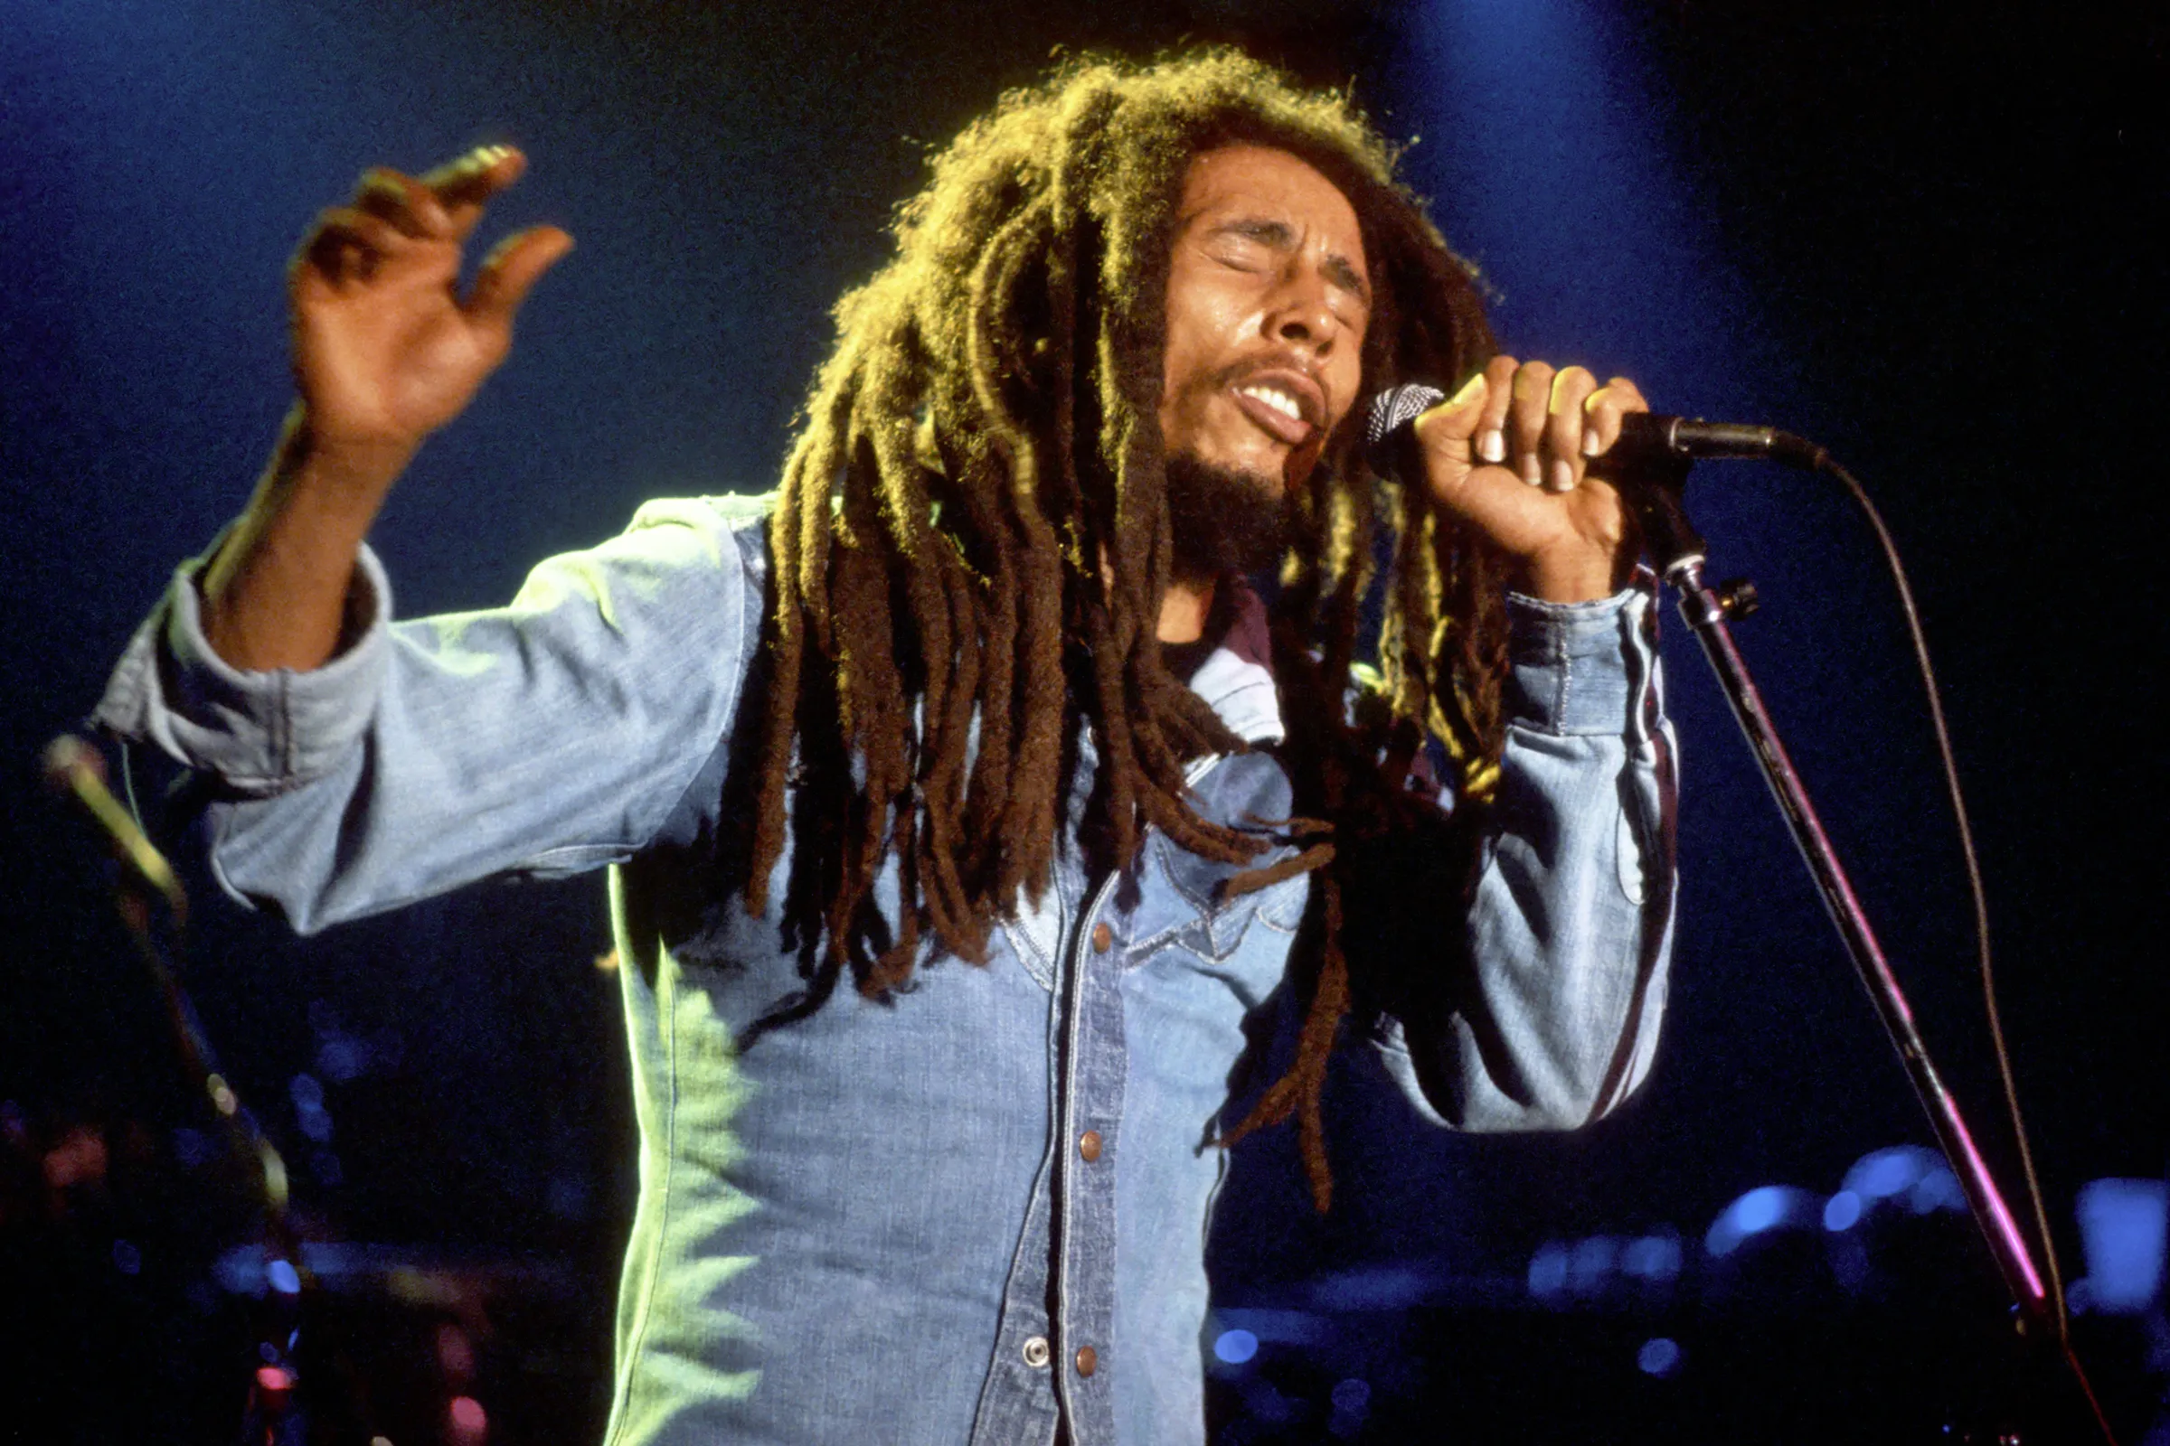
June’s musician is…
Bob Marley

Slide 11


July’s musician is…
Destiny’s Child

