Slide 1




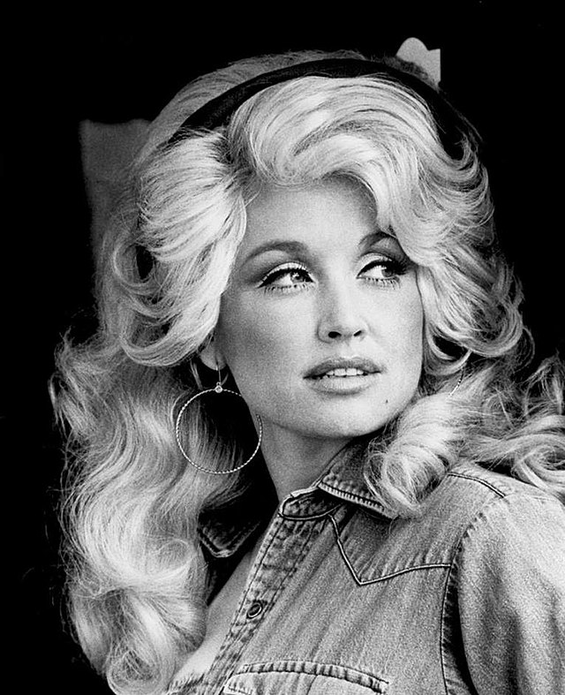


September’s musician is…
Dolly Parton

Slide 2

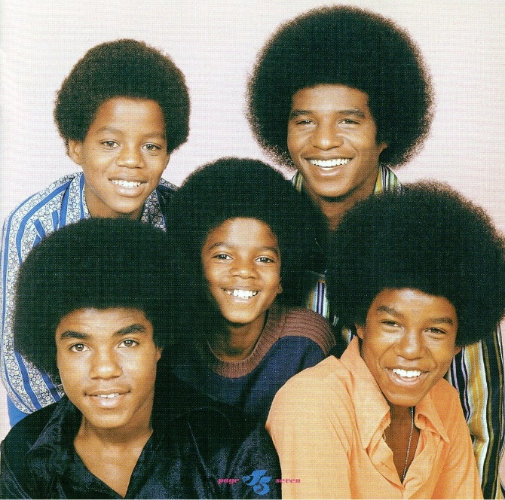
October’s musician is…
The Jackson Five

Slide 3

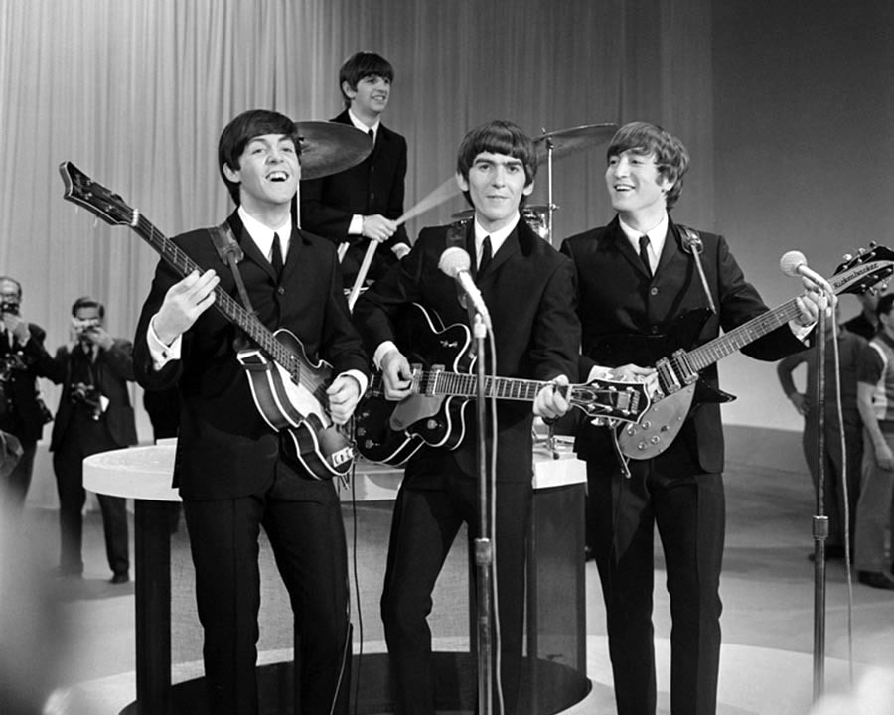
November’s musician is…
The Beatles

Slide 4

December’s musician is…
Ludovico Einaudi

