Slide 1

SATS MEETING

Slide 2
SATS
Statutory tests will be administered in the following subjects on the following dates:
Monday May 9th 2022: Spelling, punctuation and grammar (Grammar/Punctuation Test) – 45 minutes
Monday May 9th 2022: Spelling, punctuation and grammar (Spelling Test) – 20 minutes. 20-word aural spelling test
Tuesday May 10th 2022: Reading Test – 60 minutes. This is one paper, with questions that are based on 3 different passages of text.
Wednesday May 11th 2022: Maths Paper 1 (Arithmetic) – 30 minutes
Wednesday May 11th 2022: Maths Paper 2 (Reasoning) – 40 minutes
Thursday May 12th 2022: Maths Paper 3 (Reasoning) – 40 minutes

Slide 3

On SATs Week:
Children are all asked to come to school for 8.30 where we will provide breakfast (free of charge) in Mrs Lomberg’s classroom.
We know children can feel anxious in the morning’s of the tests so our aim is to provide them with reassurance and a calm start during this time.

Slide 4
- All tests are externally marked. Children’s writing will be ‘Teacher Assessed’ internally.
- The tests will take place during normal school hours, under exam conditions
- Children are not allowed to talk to each other from the moment the assessments are handed out until they are collected after the test has ended
- Afterwards, the completed papers are sent away to be marked externally
- The children’s results are sent back to school at some point in July

Slide 5
Key stage 2 SATs Changes over time
- ‘Old’ national curriculum levels (e.g. Level 3, 4, 5) have now been abolished, as set out in the government guidelines.
- Since 2016 test scores have been reported as ‘scaled scores’.
- Your child will be taught with the highest expectations and cover all required elements of the curriculum.
- The new curriculum is more rigorous and sets high expectations which all schools and their children have had to work hard to meet.

Slide 6
Scaled Scores
- A score of 100 will always represent the ‘national standard’ in SATs tests.
- Each pupil’s raw test score will therefore be converted into a score on the scale, either at, above or below 100.
- A child who achieves the ‘national standard’ (a score of 100) will be judged to have demonstrated sufficient knowledge in the areas assessed by the tests – expected standard.
- Each pupil will receive:
  A raw score (number of raw marks awarded).
  A scaled score in each tested subject.
  Confirmation of whether or not they attained the national standard.

Slide 7
How we are helping in school
Although we will maintain our broad and balanced curriculum during the lead up to SATs there will be extra revision sessions in class
Children ALL attend 3x lunch time boosters per week with different members of staff across school
Interventions are run by support staff throughout the school day either 1-2-1 or in small groups to target specific gaps in children’s understanding
Homework will now focus on revision for the test papers

Slide 8
Helpful things you can do
First and foremost, support and reassure your child that there is nothing to worry about and they should always just try their best. Praise and encourage!
Ensure your child has the best possible attendance at school.
Support your child with any homework tasks.
Reading, spelling and arithmetic (e.g. times tables) are always good to practise.
Talk to your child about what they have learnt at school and what book(s) they are reading (the character, the plot, their opinion).
- TT Rockstars https://ttrockstars.com/ children have personal login
- Hit the button https://www.topmarks.co.uk/maths-games/hit-the-button
- CGP Books https://www.cgpbooks.co.uk/
- Oxford Owls https://www.oxfordowl.co.uk/
            Username: lombergslobsters
            Password: Lobster45

Slide 9
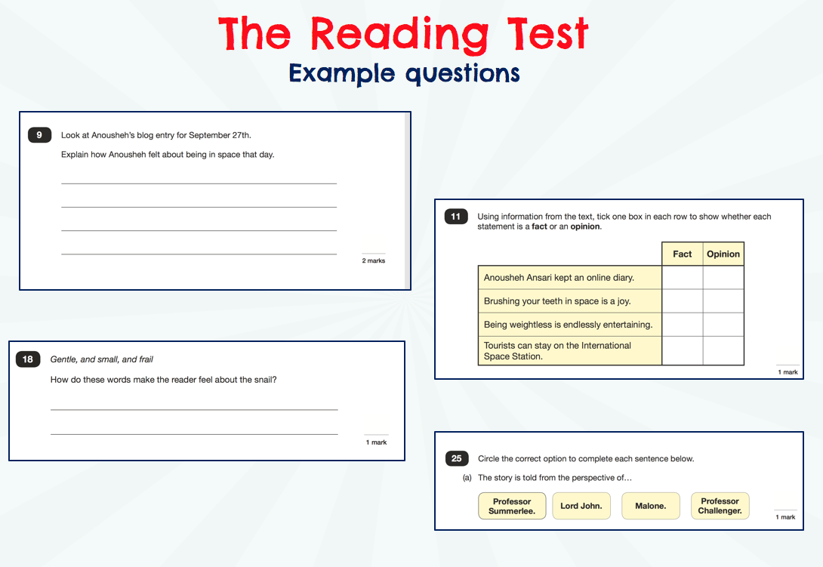
©Ks2history 2018

Slide 10
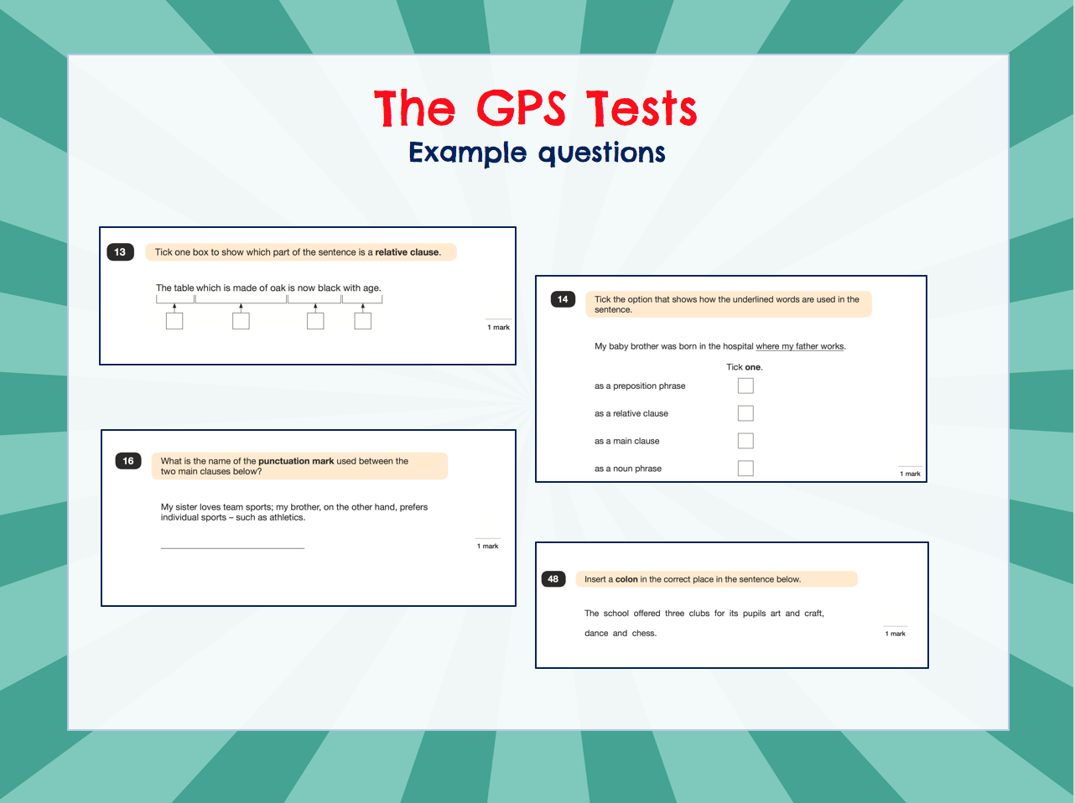

Slide 11


