Slide 1
Year 2 SATS
Take place Monday 16th May – Friday 20th May 2022
There are 2 maths papers/2 reading papers/ 1 spelling test and 1 GPS paper
Results do NOT define their end of year assessment they are used in addition to teacher assessment
Children will NOT know these are taking place

Slide 2
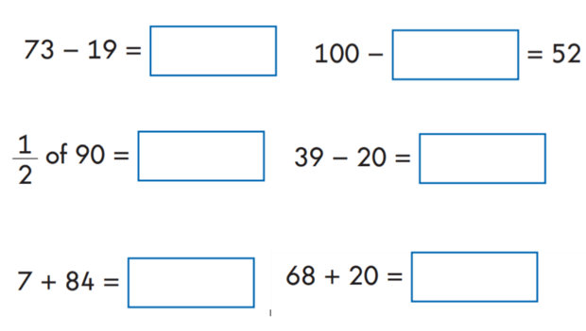
Example of maths paper 1 - arithmetic

Slide 3
Rules for Maths paper 1 - arithmetic
Numbers can be read to children but symbols can not.
It is estimated to take 20 minutes but some children may require longer
All children will be sat in class or in the resource area with a teacher or teaching assistant
Children can not use equipment to help them answer questions
There are 25 questions all at 1 mark each

Slide 4
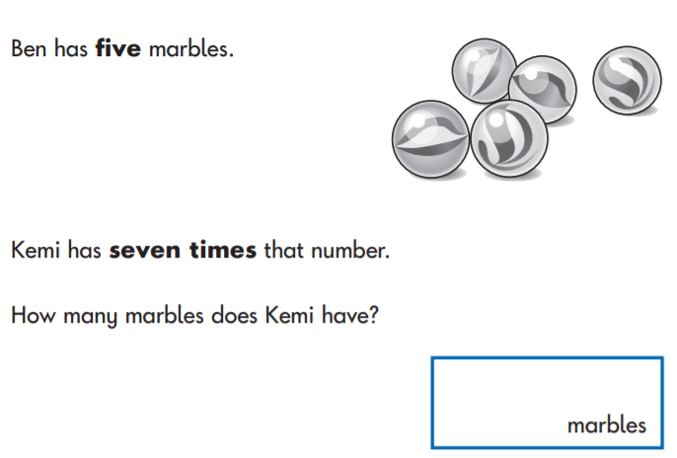
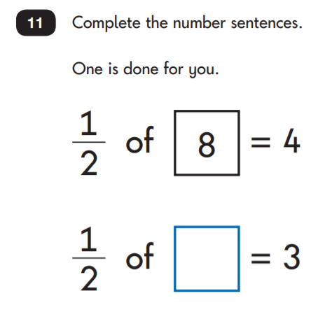
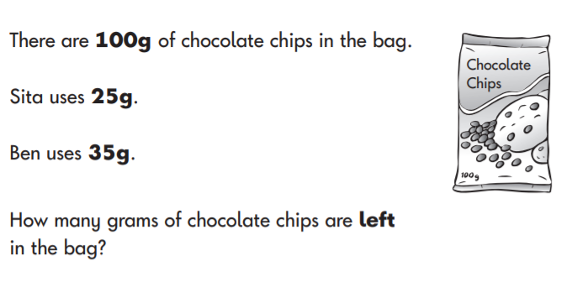
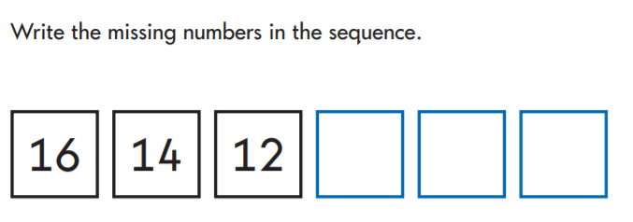
Example of Maths paper 2 - reasoning

Slide 5
Rules for Maths paper 2 - reasoning
It is estimated to take 35 minutes but some children may require longer
All children will be sat in class or in the resource area with a teacher or teaching assistant
Children are given a pencil, ruler, mirror and rubber
There are 35 questions. Some 1 mark and some 2 marks
Questions will be read but no mathematical symbols will be read out loud

Slide 6
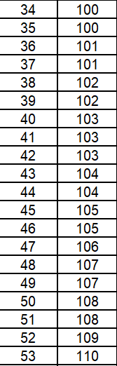
Expected scores
These can change – these are the last examples from 2019.
A scaled score of 100-109 is expected
A scaled score of 110 is working above
Paper 1 is out of 25. Paper 2 is out of 35.
In total there are 60 marks to get in both papers
In order to get age expected your child would need to get at least 34 questions correct

Slide 7
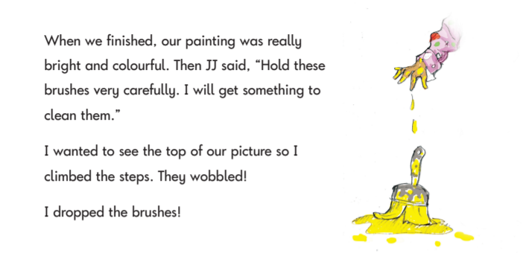
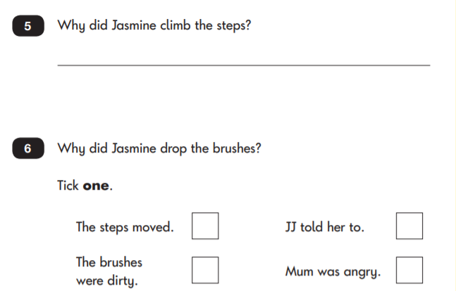
Example of reading Paper 1

Slide 8
Rules for Reading paper 1
It is estimated to take 30 minutes but some children may require longer
All children will be sat in class or in the resource area with a teacher or teaching assistant
The practise questions are read with some of the text and then children will continue on their own
Nothing else can be read or explained to children
There are 20 marks to get on this test

Slide 9
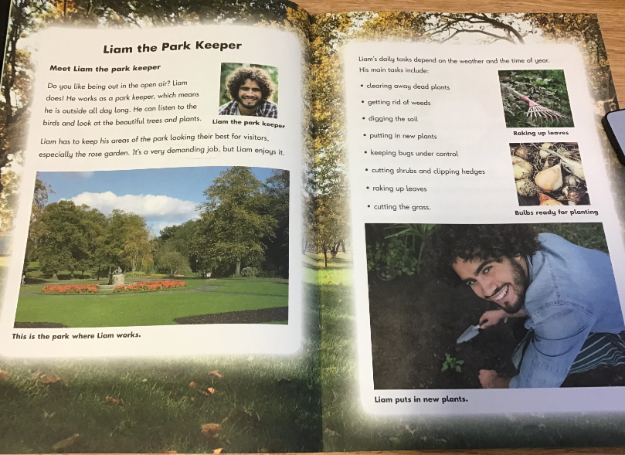
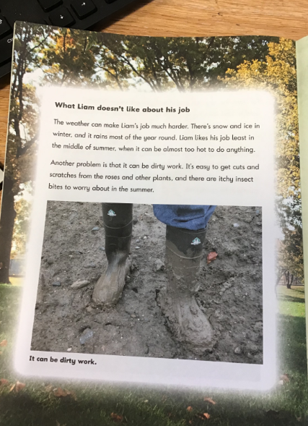
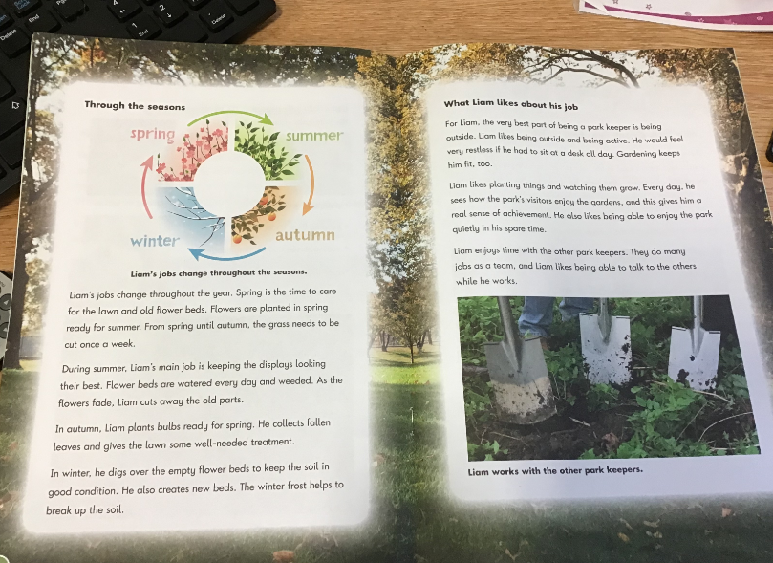
Example of reading Paper 2 Booklet
Children must read this independently

Slide 10
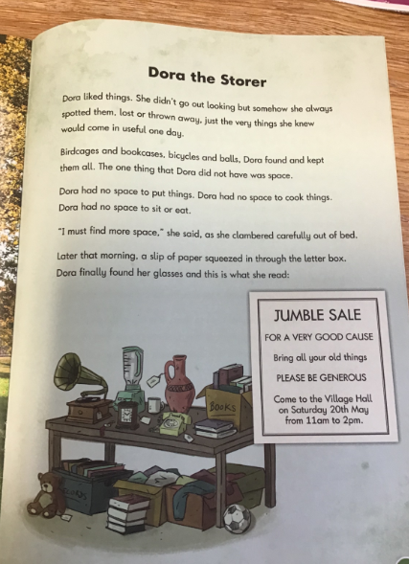
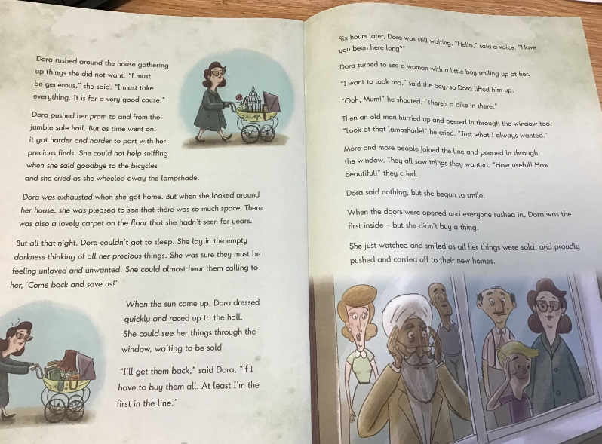
Example of reading Paper 2 Booklet
Children must read this independently

Slide 11
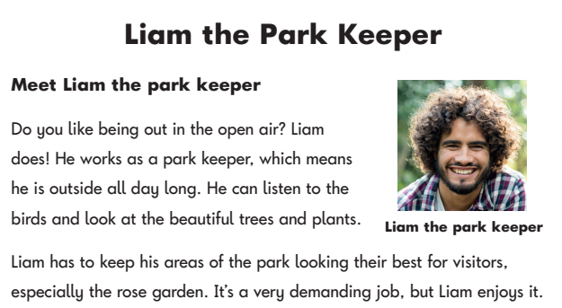
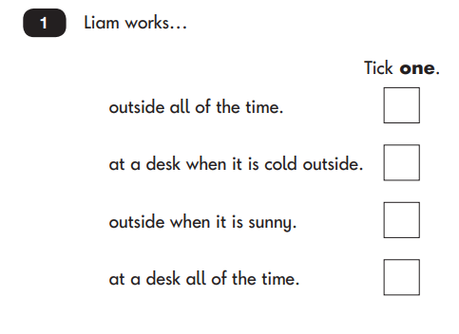
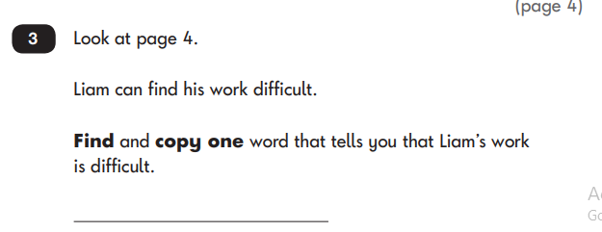
Example of reading Paper 2

Slide 12
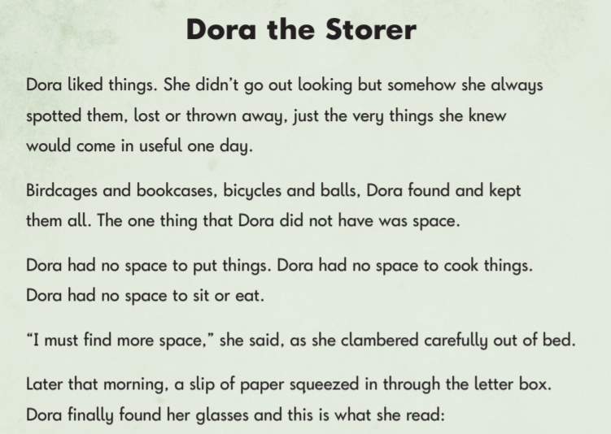
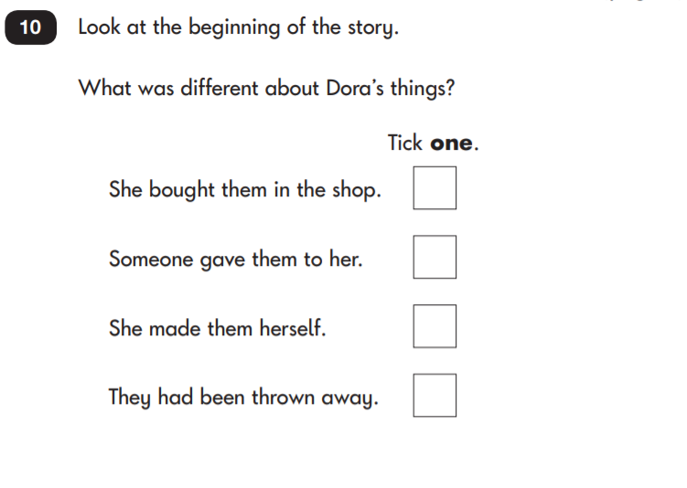
Example of reading Paper 2

Slide 13
Rules for Reading paper 2
It is estimated to take 40 minutes but some children may require longer
All children will be sat in class or in the resource area with a teacher or teaching assistant
Nothing can be read or explained to children except instructions
There are 20 marks to get on this test

Slide 14
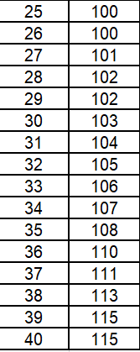
Expected scores
These can change – these are the last examples from 2019.
A scaled score of 100-109 is expected
A scaled score of 110 is working above
Paper 1 is out of 20. Paper 2 is out of 20.
In total there are 40 marks to get in both papers
In order to get age expected your child would need to get at least 25 questions correct

Slide 15
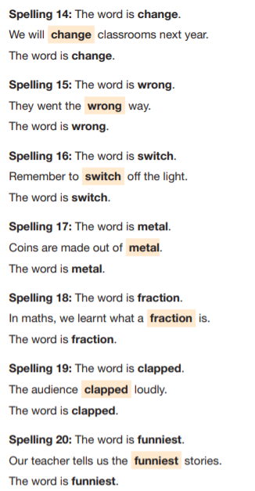
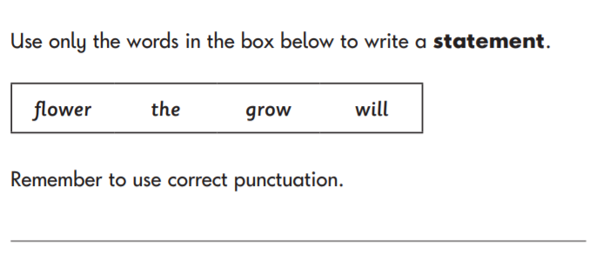
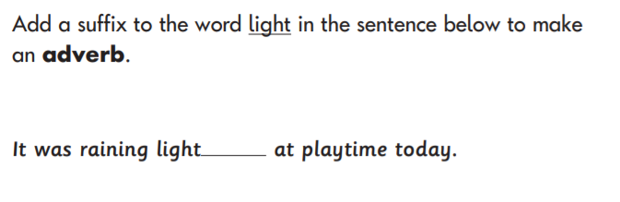
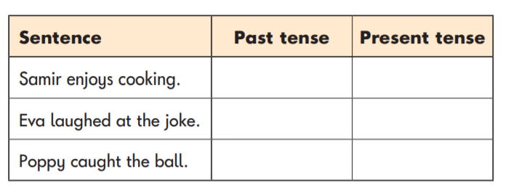
Example of grammar and spelling test

Slide 16
Rules for GPS paper
It is estimated to take 15 for spelling and 20 minutes for GPS but some children may require longer
All children will be sat in class or in the resource area with a teacher or teaching assistant
Spellings will be read twice on their own and in a sentence
All questions will be read to children but nothing will be explained. E.g.. A noun is….
There are 40 marks in total to get on these tests

Slide 17
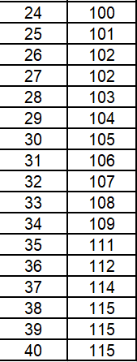
Expected scores
These can change – these are the last examples from 2019.
A scaled score of 100-109 is expected
A scaled score of 110 is working above
Spelling is out of 20. GPS is out of 20.
In total there are 40 marks to get in both papers
In order to get age expected your child would need to get at least 24 questions correct

Slide 18
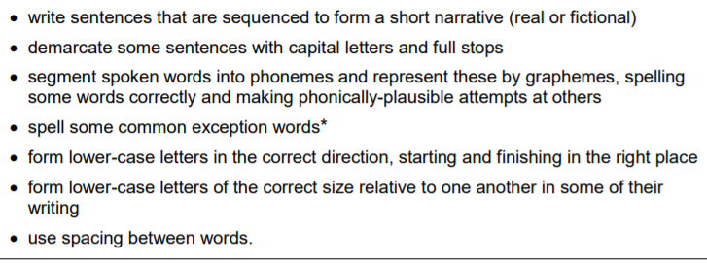
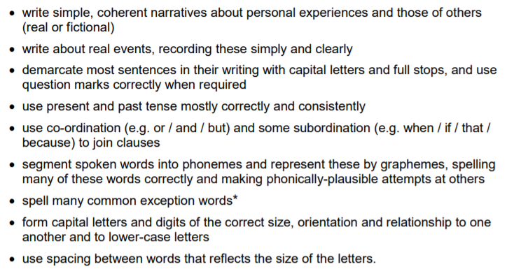
Writing
Writing is teacher assessed in Year 2. For your child to reach expected standard in writing they must be able to:

Slide 19
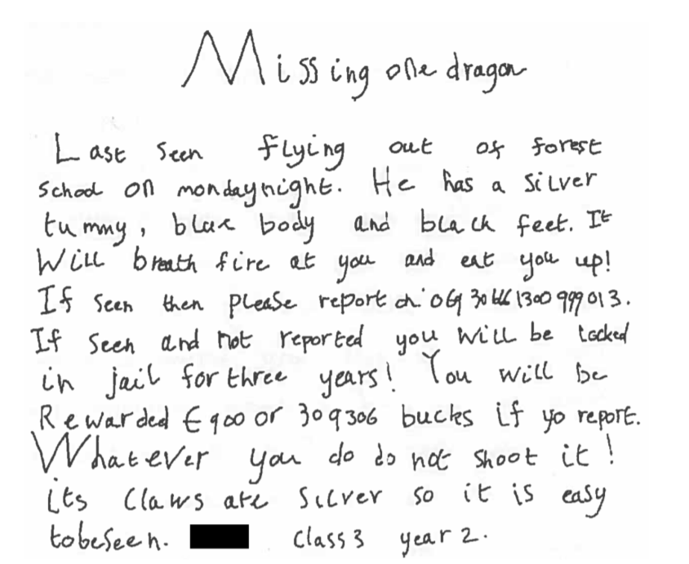
Age expected example of writing in Year 2

Slide 20
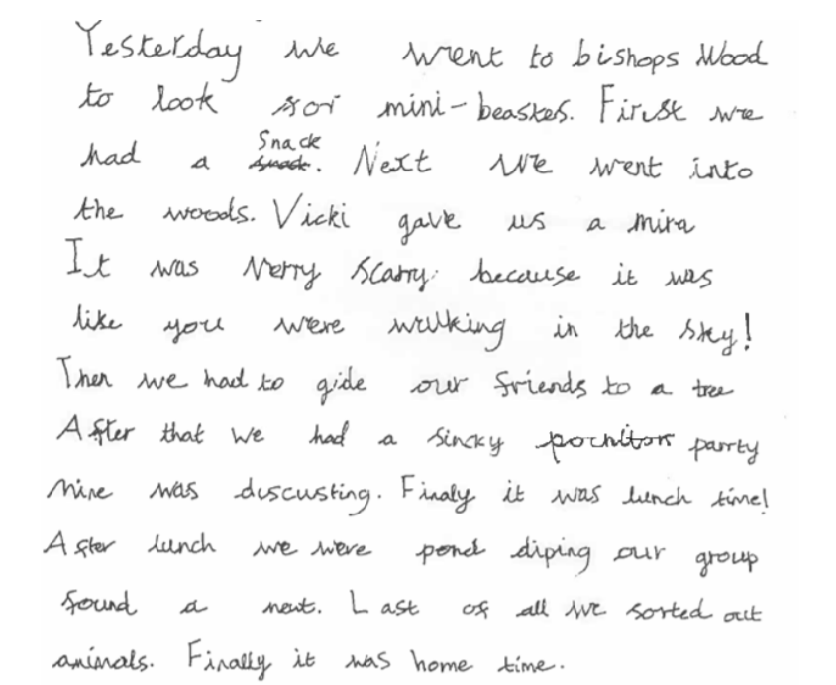
Age expected example of writing in Year 2

Slide 21
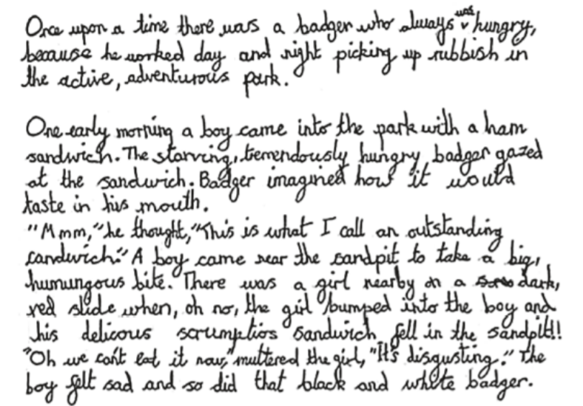
Above age expected example of writing in Year 2

