Slide 1
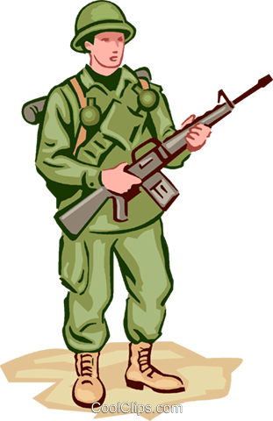
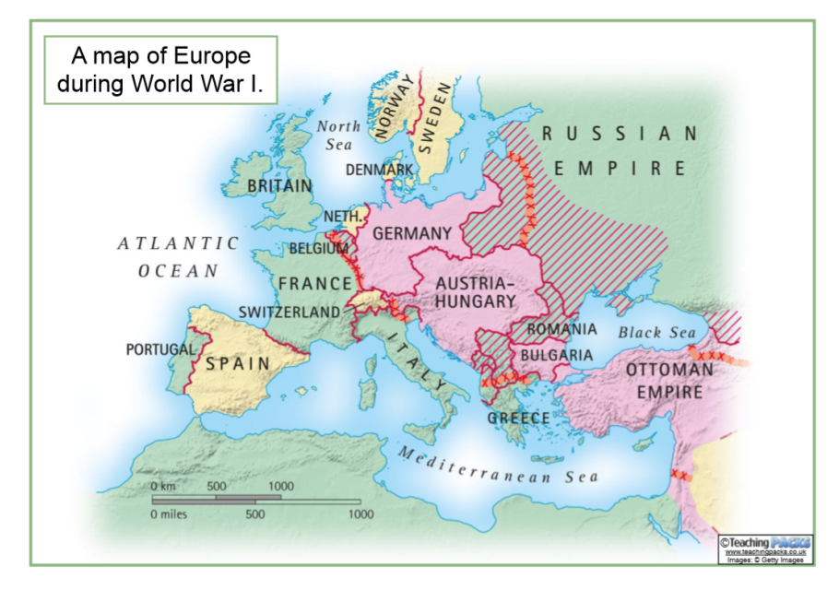

World War One and The Accrington Pals
Vocabulary
David Lloyd George
Wilfred Owen
Franz Ferdinand
Accrington Pals
infantry
soldier
army armies
battalion
allies
enemy enemies
Fight fought
the front line
trench trenches
The Battle of the Somme
conscription
armistice
Remembrance
Event | Description | Date
Archduke Franz Ferdinand is assassinated | Archduke Franz Ferdinand of Austria is assassinated. Following a number of threats, Austria-Hungary declares war on Serbia. | 28th June 1914 28th July 1914
Other nations begin to join the war | Germany declares war on Russia in support of Austria-Hungary before declaring war on France. Following a German invasion of Belgium, Britain declares war on Germany. | August 1914
Accrington Pals begins | Lord Kitchener called for volunteer armies and the 11th Battalion East Lancashire Regiment, better known as the Accrington Pals, was formed. | Began on 14 September 1914
Trench Warfare | The German army is stopped short of Paris by British and French soldiers. Both sides dig in and trench warfare begins with only tiny gains achieved | September 1914 before continuing throughout
Battle of the Somme | The Accrington Pals fought with other British and French soldiers, attacking the German trenches near the River Somme in France. On the attack on Serre, on the first day of the battle, the Accrington Pals suffered devastating losses. | 1 Jul 1916 - 18 Nov 1916
America joins the war | The United States of America declares war on Germany, providing France and Britain with much needed financial and military support. | April 1917
Russia leaves the war | Following a revolution in Russia that sees new leaders, Russia signs an armistice that sees them withdraw from the war. | December 1917
Fighting comes to an end | Fighting comes to an end. An armistice is agreed that sees Germany admit defeat at the end of the war. Guns officially fall silent at 11am. | 11th November 1918

Slide 2

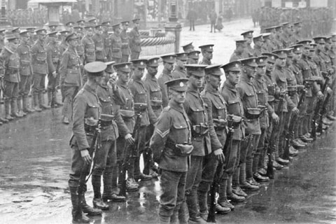
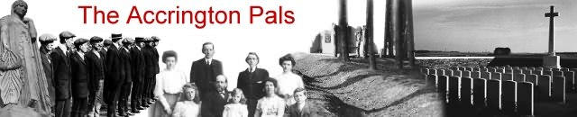
IMPORTANT FACTS TO LEARN:
The assassination of Archduke Franz Ferdinand (heir to the Austrian monarchy) in Sarajevo, Bosnia, on 28th June 1914, triggered a chain of events that caused World War One.
World War One started on 28th July 1914.
There were two main alliances – The Triple Entente (Britain, France and Russia) and The Central Powers (Germany and Austria-Hungary).
Lord Kitchener called for volunteer armies needed for the war and the Accrington Pals were formed.
Soldiers lived and fought from trenches.
The Battle of the Somme, (1 Jul - 18 Nov 1916) – British and French decided to attack the trenches near the River Somme to try to take the village of Serre. On the first day of battle many soldiers from the Accrington Pals battalion lost their lives.
On the 11th hour, of the 11th day, of the 11th month, 1918, an armistice was drawn up and signed by Britain, France and Germany and the First World War ended. (11am, 11th November 1918)

