Slide 1
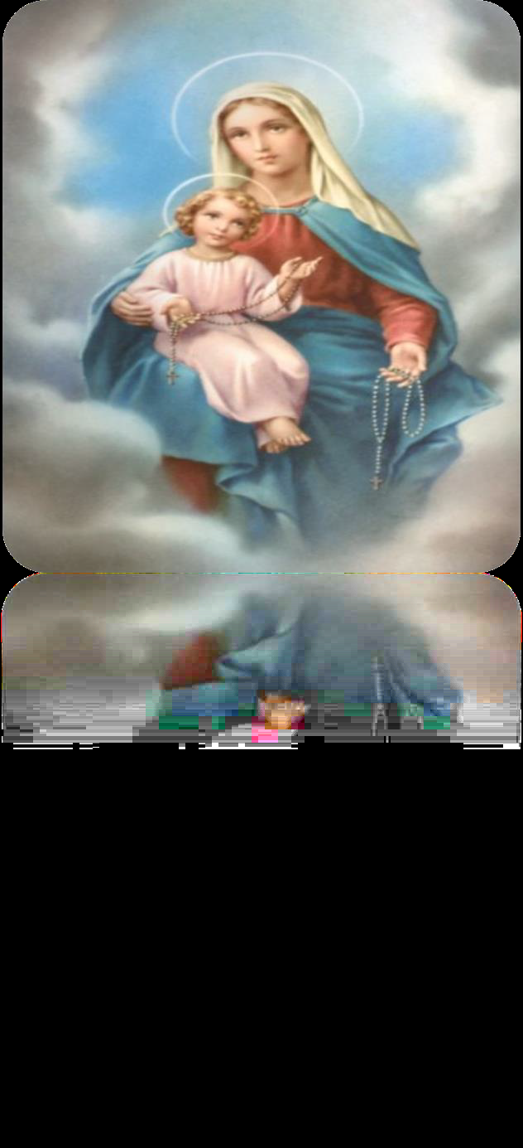
Welcome to our Gift Team Worship

Slide 2
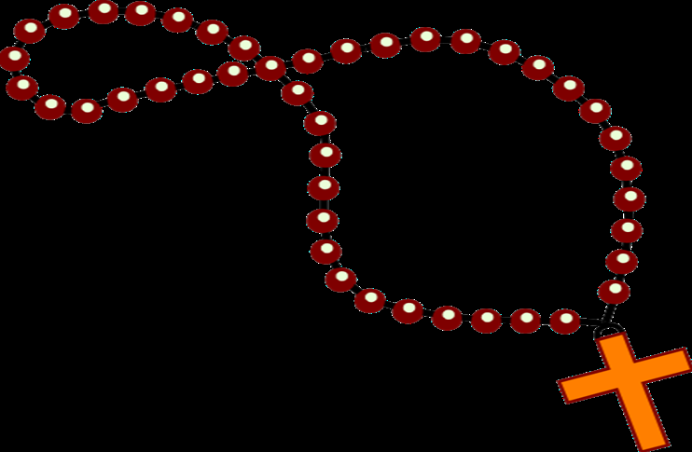
What are these?
What is the name of special prayer we say when we use them?

Slide 3
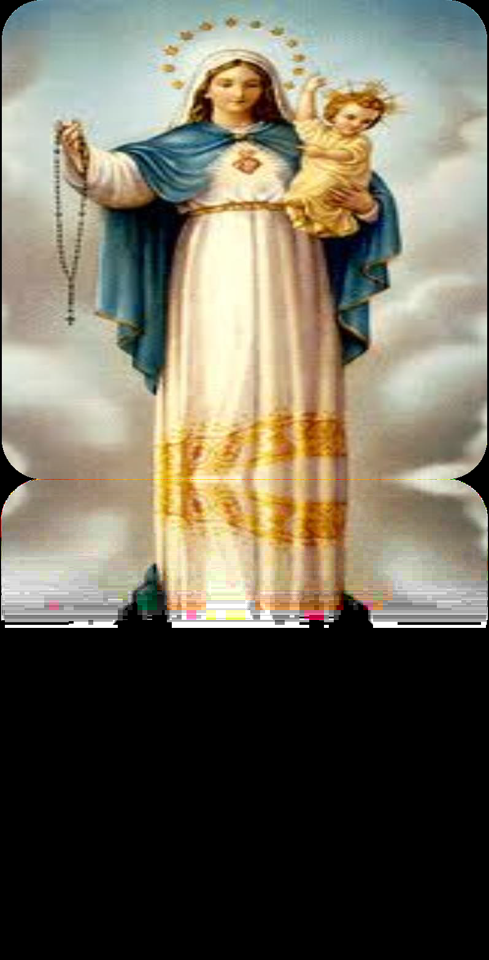
October is the month of the Rosary.
During October we
make a special effort to say the Rosary.

Slide 4
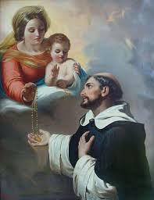
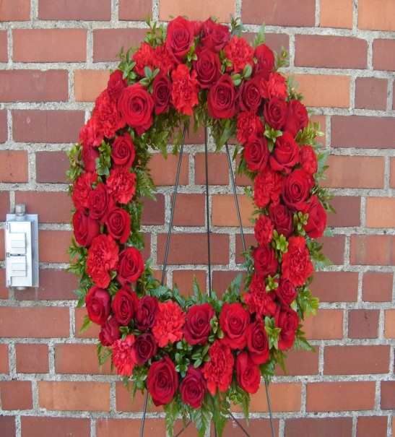
Dominic was one of the first people to say the Rosary
St Dominic -Feast day: August
Dominic was a priest who lived a long time ago.
He lived a very simple life and prayed a lot.
Our Lady appeared to Dominic and showed him a wreath of roses and told him about the Rosary.
She told him to say the Rosary daily and teach it to others.

Slide 5

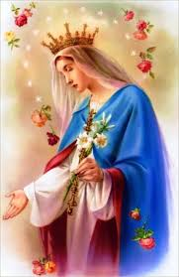
The ROSARY
The word Rosary means "Crown of Roses".
Our Lady said that each time someone says a Hail Mary they are giving her a beautiful rose and that each complete Rosary makes her a crown of roses.

Slide 6
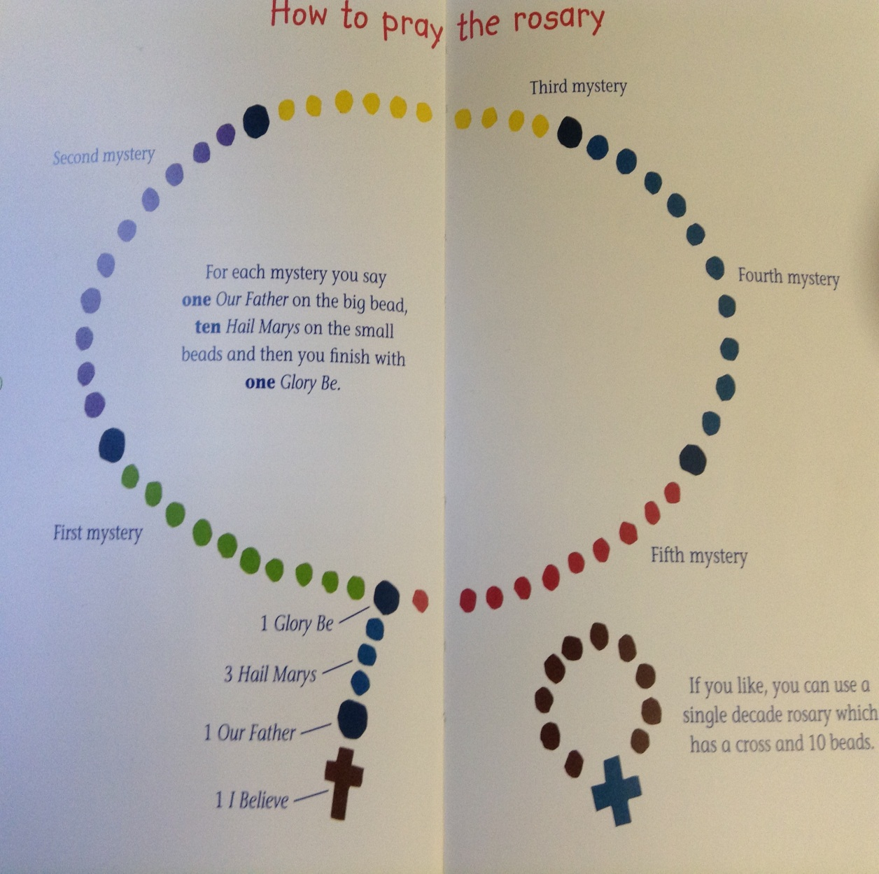
How do we pray the Rosary?
•When we say the Rosary we say these prayers:
•Our Father
•Hail Mary
•Glory be to the Father
The Rosary is a special prayer. It helps us think about the lives of Jesus and Mary.

Slide 7

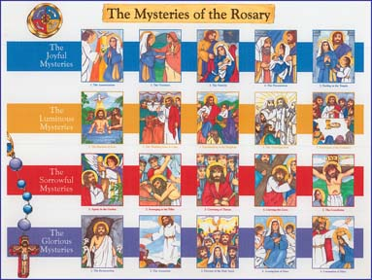
•The Rosary is like reading stories from the Bible.
•It tells us the story of Jesus in four parts.
These four parts are called mysteries.

Slide 8
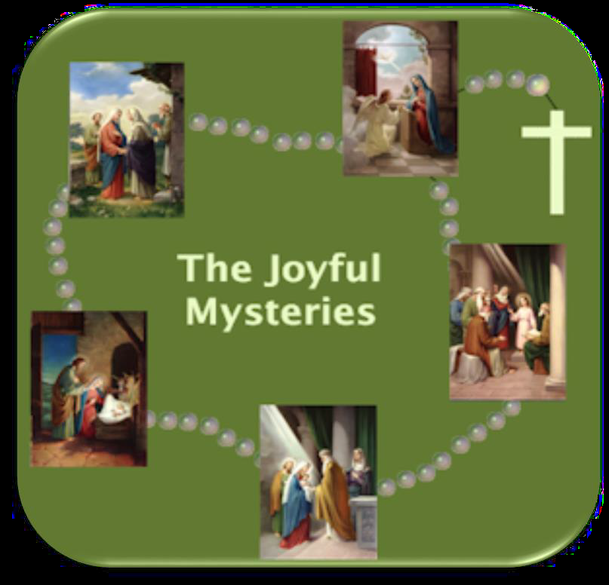
Each mystery reminds us of some of the stories we read in the Bible
Joyful Mysteries
We remember
all the happy
times in Jesus’
Life.

Slide 9
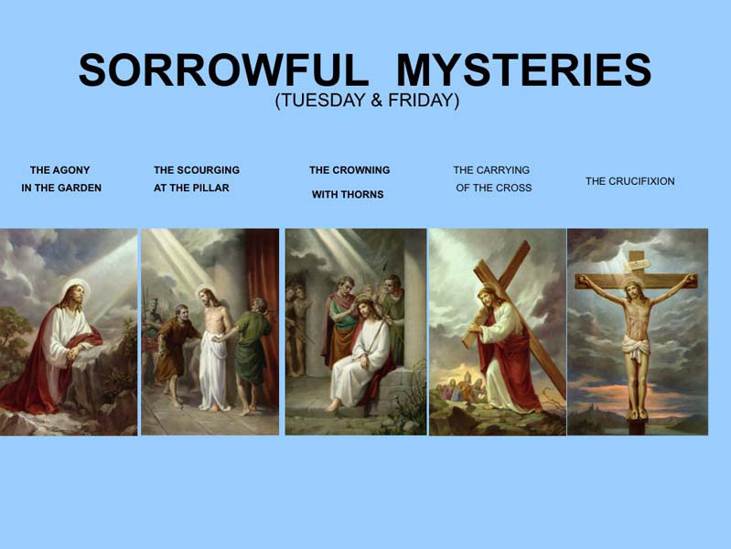
We think about the sad times in Jesus’ Life.

Slide 10

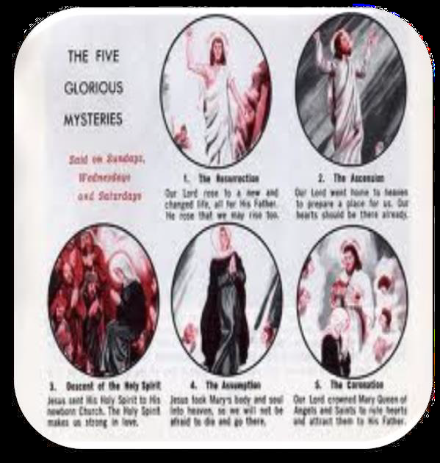
We think about
all the amazing and wonderful things that happened.

Slide 11
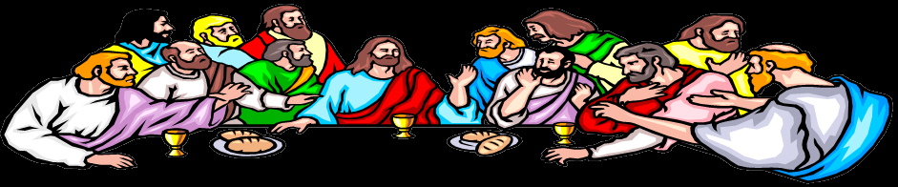
Mysteries of Light Sometimes called luminous Mysteries
We remember the important events that happened.

Slide 12
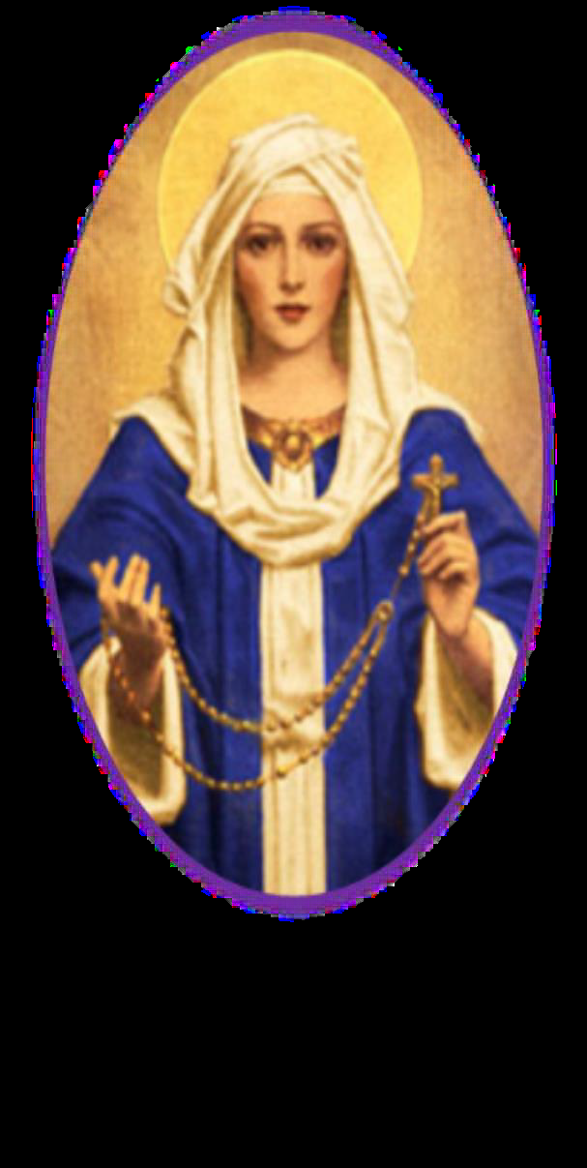
October 7this the feast of
Our Lady of the Rosary.
During October let us make a special effort to say the Rosary

